Slide 1
Conceptual framework

Slide 2
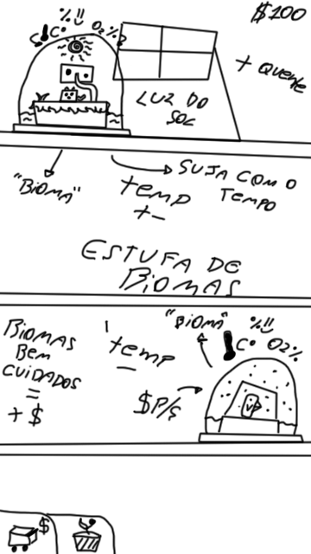

Slide 3
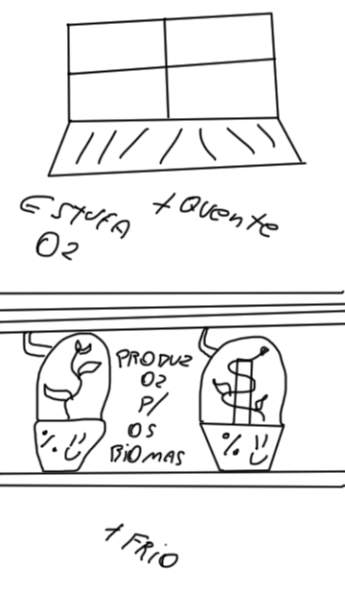

Slide 4
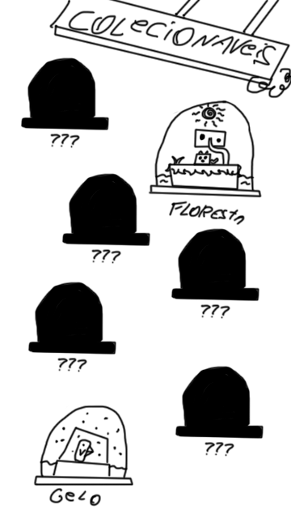

Slide 5
Demonstration Live version

Slide 6


Slide 7


Slide 8
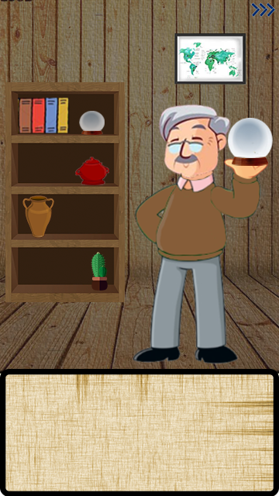
Bioma is adaptation
Of fauna and flora
In the ecosystem!
Looking at this globe, it reminds me of my past when I studied biomes.
Do you know what biomes are?

Slide 9
And fauna and flora?
You know what it is?
Fauna is the diversity of animals and flora the diversity of vegetables in a certain area!

Slide 10
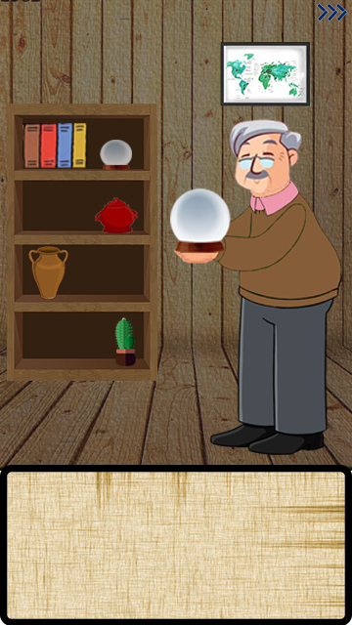
I have several biomes globes! Come closer and come and meet!

Slide 11
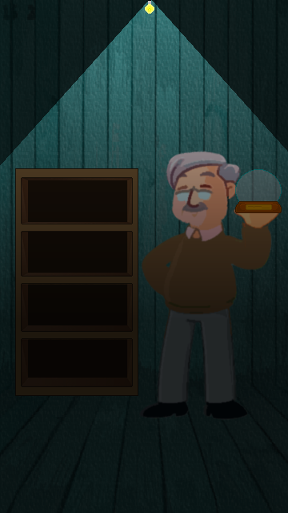

Slide 12


Slide 13


Slide 14
